Slide 1

Phase Change Energy Solutions, Inc.
www.phasechange.com

Slide 2



Our BioPCM™ products address one of the most pressing problems of our time…
the increasing demand for energy
and the limited global resources to fulfill that need.

Slide 3
What Are Phase Change Materials(PCMs)?
PCMs are materials which take advantage of a fundamental property of nature; the natural tendency of materials to absorb heat when they melt (change phase from a solid to a liquid) and to release heat when they solidify (change phase from a liquid to a solid).
PCMs can store tremendous quantities of heat per unit of mass through these transitions. When phase change materials are placed in quantity into the structure of a building, they will absorb heat (air condition) in the building as temperatures rise and release heat (heat) in the building when temperatures drop.

Slide 4
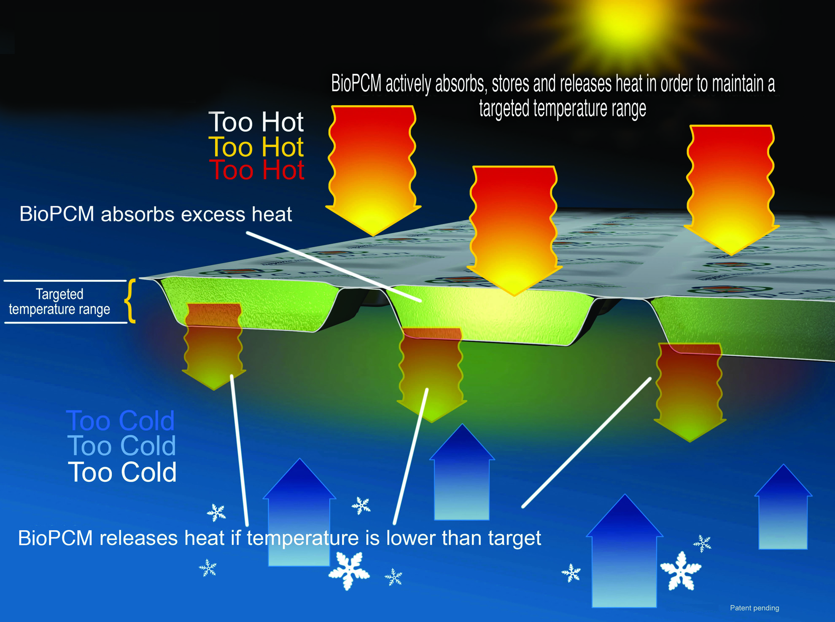
How BioPCM Works

Slide 5
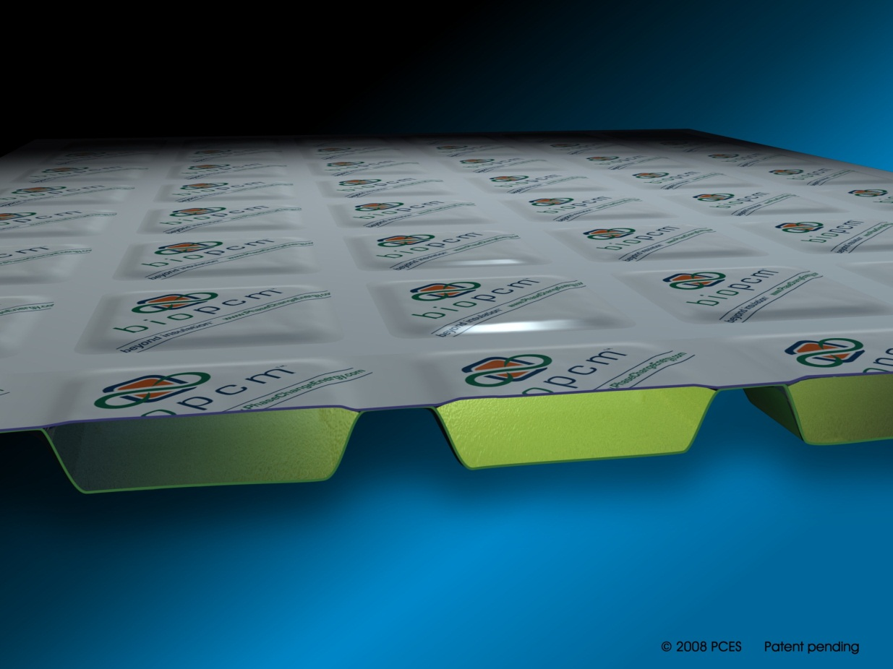
Our Current Family of Products
BioPCmat™
Available in:
23, 25, and 29 degree Celsius melt point (custom temperatures available)
.3lb (M27), .56 lb (M51), 1 lb (M91), 2lb (M182) active component per sq. ft.
approx. 180 – 200 j/g latent heat
Solid to gel transition
Class A and Class C fire rating
Permeable, non-permeable and vapor retarding available

Slide 6
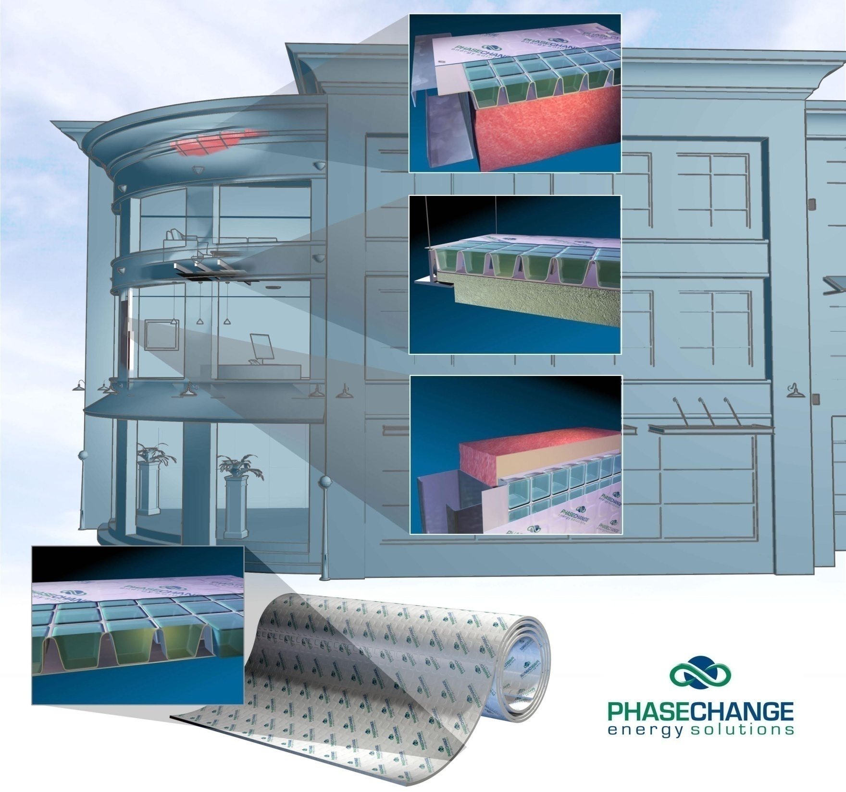
BioPCM™ Installations Methods and Energy Savings

Slide 7
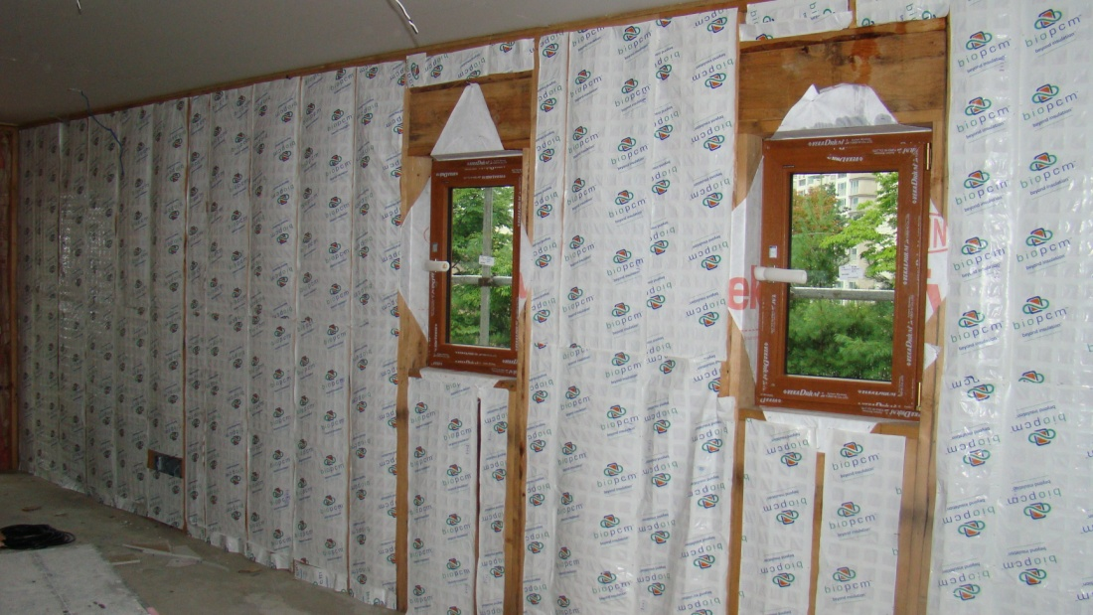
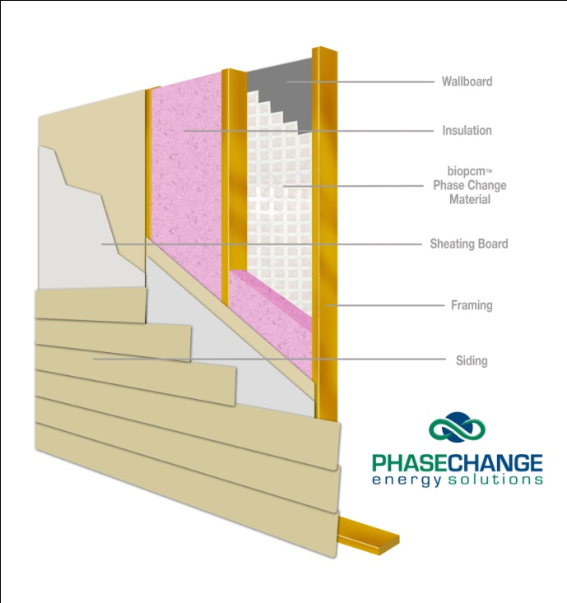
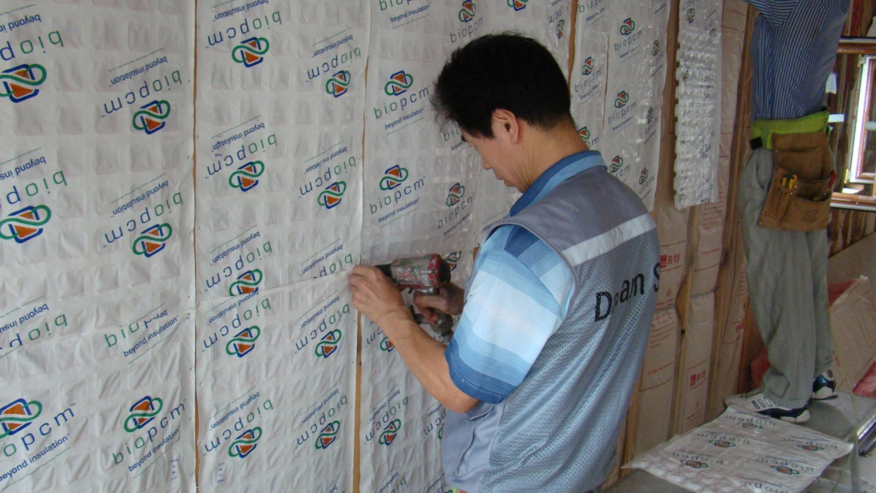
Underneath Wallboard
installed behind wallboard
reduces peak demand and heat flux through walls
helps balance out temperature differences throughout building
staple, screw or glue to metal or wood studs
Korea – BioPCM™ has been installed into multifamily homes in Seoul Korea.

Slide 8
Field Test Results

Slide 9
Annual Energy Savings
STAR Test Facility – Arizona
Two Identical Residential Buildings Except One Has bioPCmatTM added
test building (green) vs. control (red)

Slide 10
Test HVAC Run Times
STAR Test Facility – Arizona
Two Identical Buildings Except One Has bioPCmatTM added
test building (green) vs. control (red)

Slide 11
Measured Energy Savings for a Typical Day
STAR Test Facility – Arizona
Two Identical Buildings Except One Has bioPCmatTM added
test building (green) vs. control (red)

Slide 12
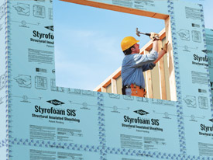
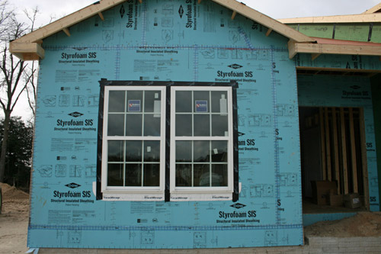
PCM’s can greatly enhance building envelope performance
Calculating the effect of BioPCM™ using the Steady State Heat Transfer method
Using Empirical units-- The simplified equation for calculating steady state heat transfer is as follows:
Using steady state heat transfer equation,
if Outside temperature is 90 ⁰ F and Inside Temperature is 71⁰ F the Heat Flux = = 1 btu per hour per sq. foot
R5 Foam
R13 Fiberglass
R1 Wallboard

Slide 13
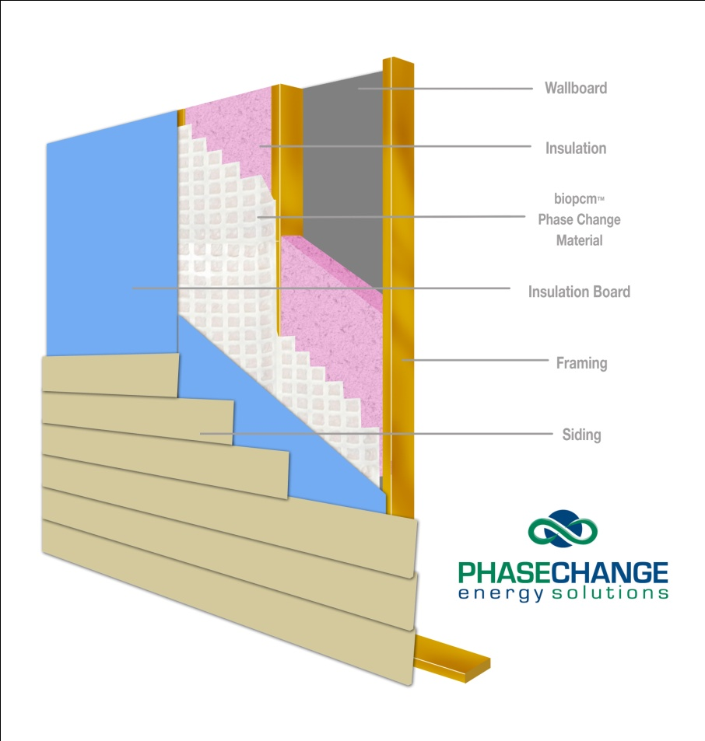
The Science Behind How PCM’s Work
Same dimension Wall Section with 73⁰ F melting point BioPCM™
Using steady state heat transfer equation,
if a layer of BioPCM™ set to 73 ⁰ F is installed as below and Inside Temperature is 71⁰ F then the Heat Flux into the building is =
= .143 btu per hr. per sq. foot
R5 Foam
R13 Fiberglass
R1 Wallboard
BioPCM™™
This is equivalent to an R value of 133
To get the same performance with only fiberglass insulation you would need a wall 36” thick!!!

Slide 14
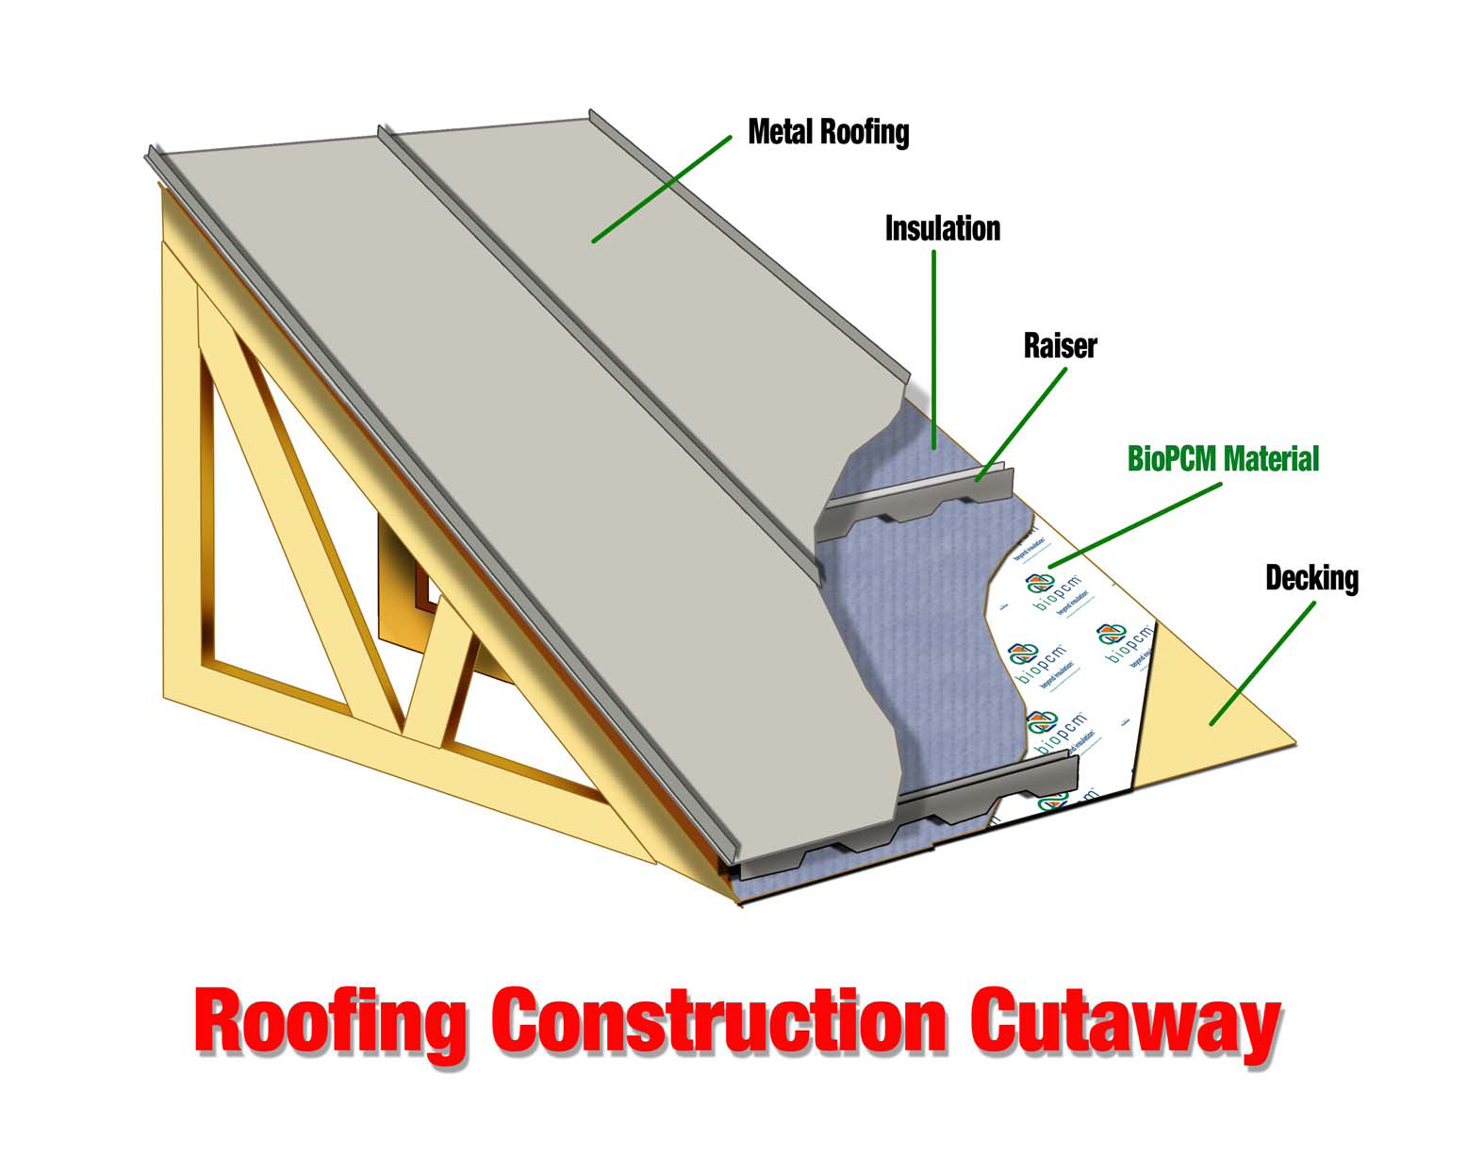
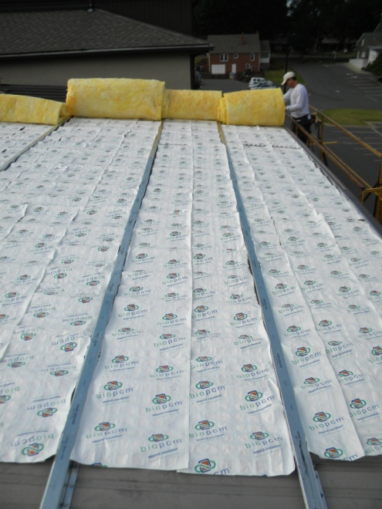
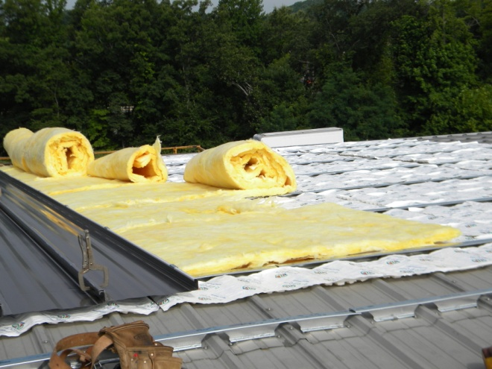
BioPCM™ Metal Roofing
Department of Energy – Metal Construction Association
BioPCM™ Cool Roof Design
Developed by Oak Ridge National Lab, funded by MCA
Showed 30% reduction in Heating Load,50% reduction in Cooling Load and 75% reduction in nighttime heat loss
System is commercially available from Fabral & PCES, Inc.
Simple Retrofit over existing roofing shingles without tear off
Easy non invasive method to retrofit buildings with sloped roofs.
Great new roof design.

Slide 15
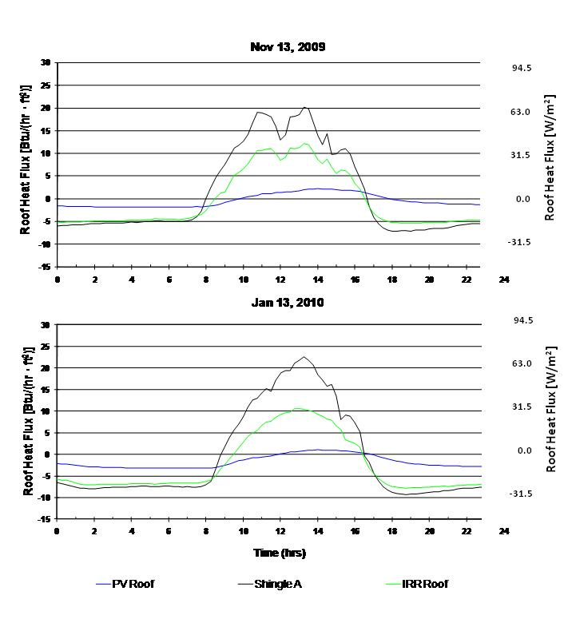
DOE – MCA roof dramatically reduces heat flux
Oak Ridge National Laboratory Test Results

Slide 16
Oak Ridge National Laboratory Test Results

Slide 17
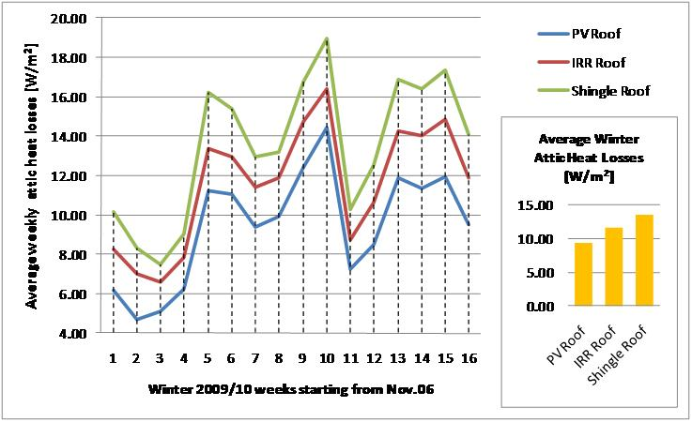
Oak Ridge National Laboratory Test Results
bioPCmatTM under metal roofing

Slide 18
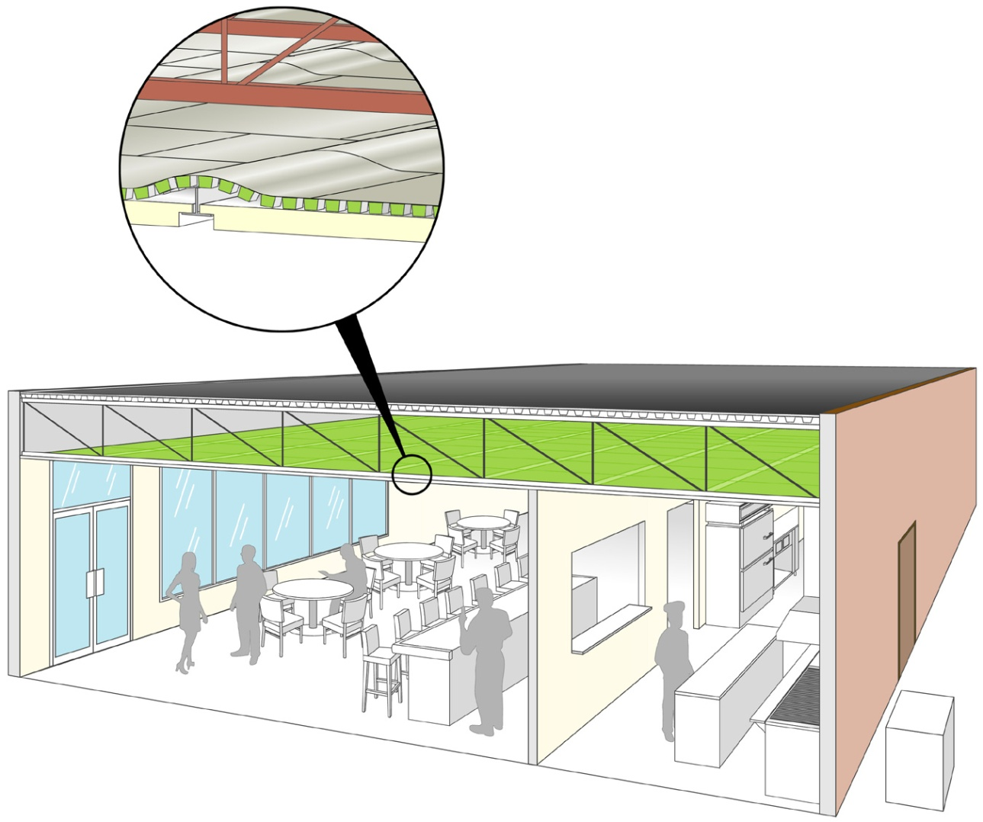
Easy Restaurant Retrofit bioPCmatsTM are placed above ceiling tiles
This application has a very fast return on investment… 18 to 30 months
Typical savings average greater than 12 percent on total energy

Slide 19
Simple Restaurant Retrofit yields substantial savings
GREEN = BioPCM™ restaurant total 2010 vs. 2009 monthly energy usage
RED = Control restaurant total 2010 vs. 2009 monthly energy usage

Slide 20
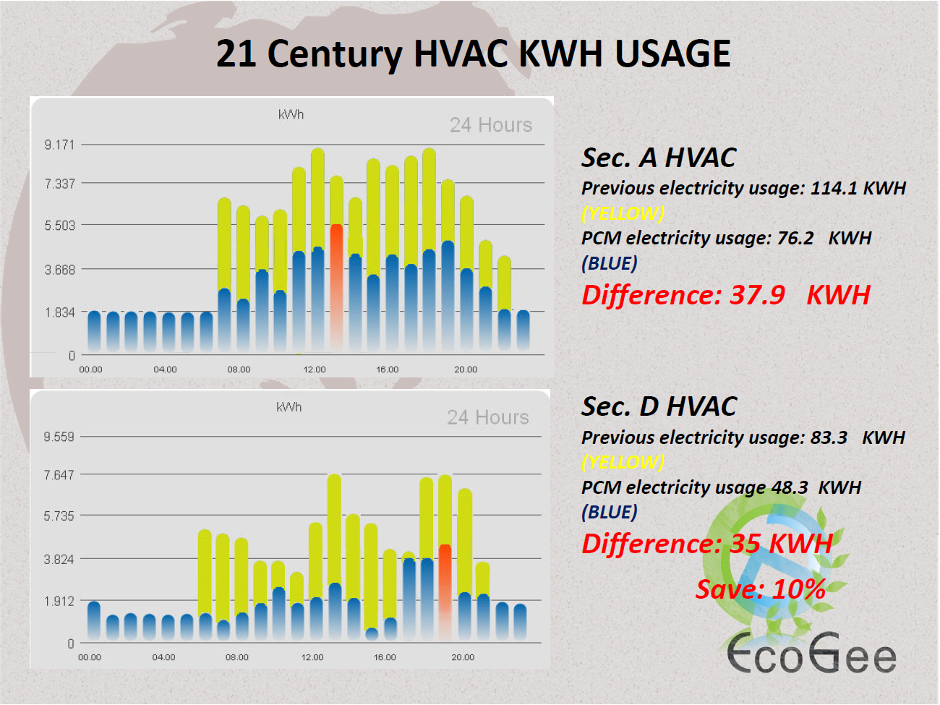
Taiwan BioPCM™ Restaurant Savings

Slide 21
BioPCM™ “Before and After” Field Test
Comfort Level Is Improved Along With Costs
With BioPCMTM(green) vs. control (red)

Slide 22
Why This is an Exciting Product Offering
Our products are economically viable today, without tax credits or other government incentives. The ROI is estimated to be between 6 months and 5 years depending on application. In certain new builds, savings by downsizing HVAC will more than pay for the installation of our material.

Slide 23
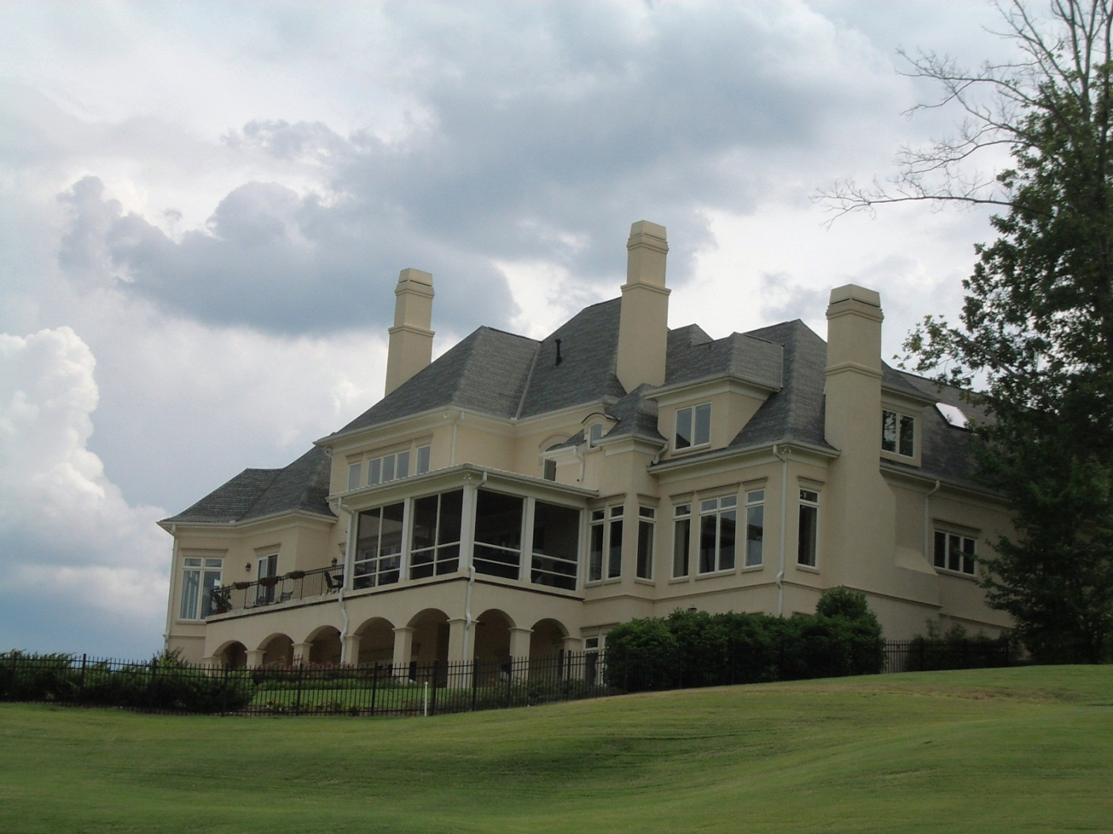
Current BioPCM™ Projects

Slide 24
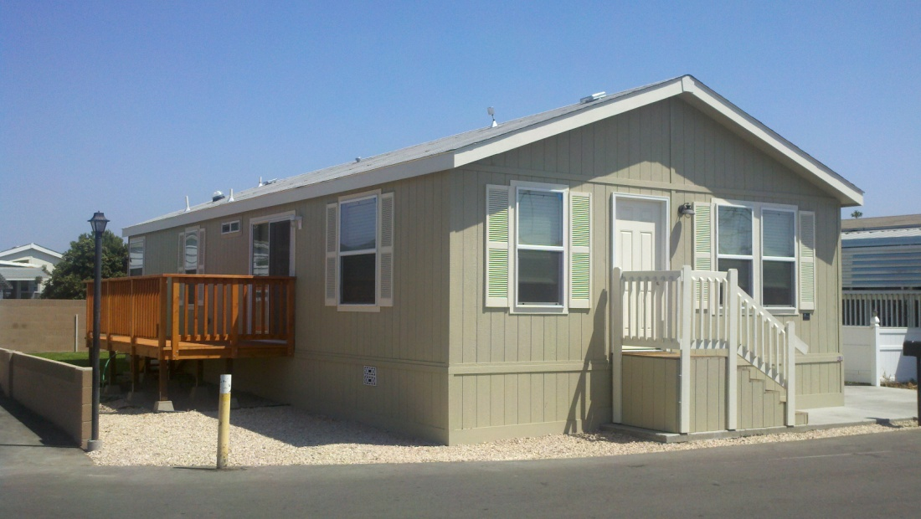
Modular Life Styles Net-Zero Homes
“my entire electric bill for the past year, including home heating and air conditioning, was about $15”
- Bill Haff, Ojai, CA
Modular Life Styles receives SCE Advanced Energy Rating with only R11 walls and BioPCM™
Homes are currently installed in 5 CA climate zones
Homes have 1.1KW of PV and sell surplus into grid

Slide 25
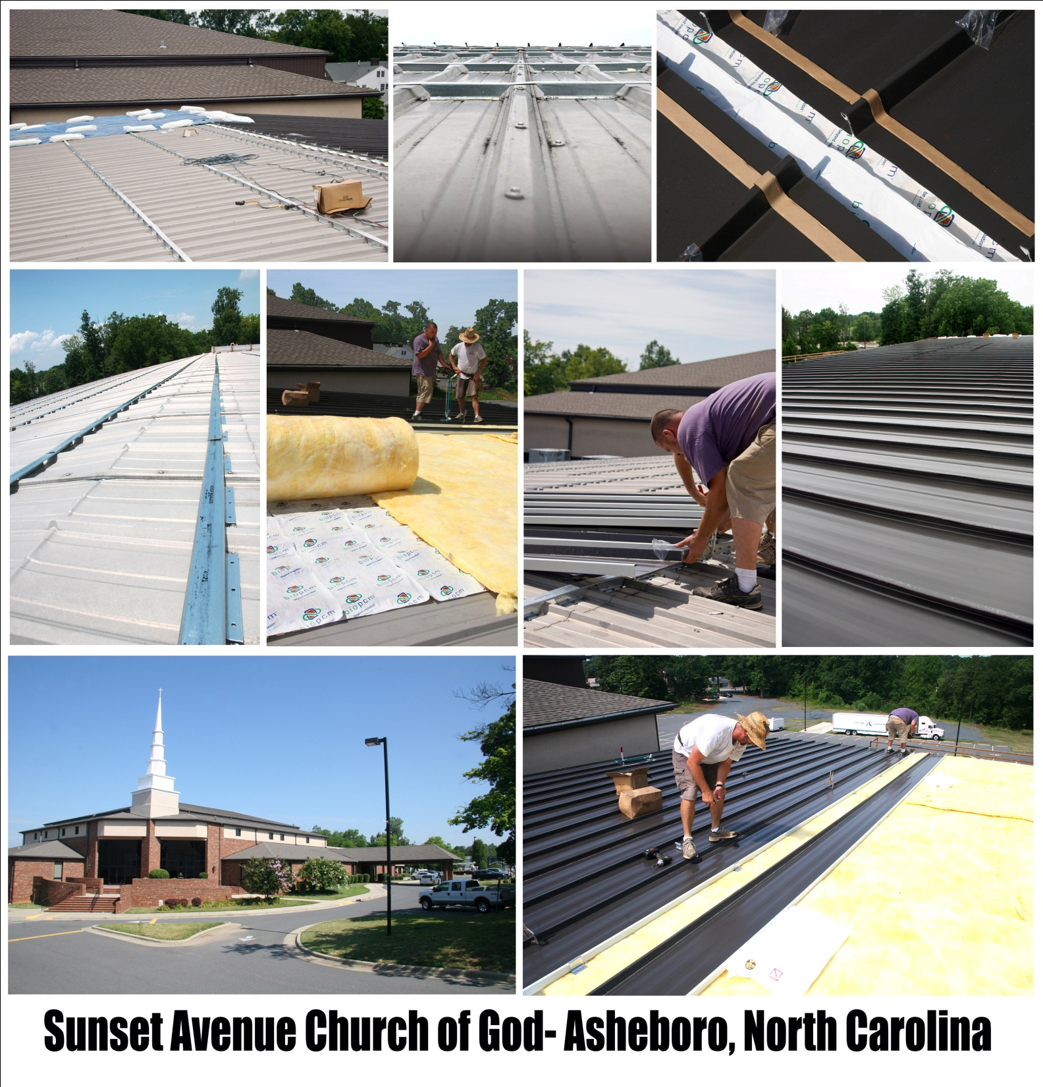
Peak Summer Internal Temperatures reduced from 95F to 79F
15 Hour cool down reduced to 3 Hours
Energy Usage is currently being measured. First two months of data show a savings of approximately 50%

Slide 26
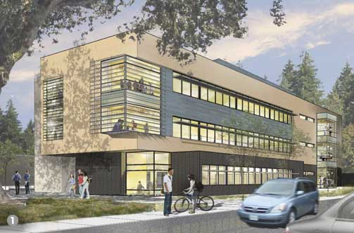
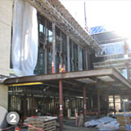
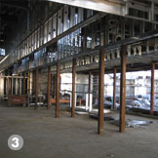
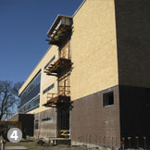

CHEMEKETA COMMUNITY COLLEGE
YAMHILL VALLEY CAMPUS
PHASE 1 BLDG
59,000 sq. ft., three-story building, housing registration and administration offices, classrooms, science labs, faculty offices, library, food service, and support spaces.
Building will use 128,000 BTU’s of BioPCM™ Capacity to supplement HVAC

Slide 27

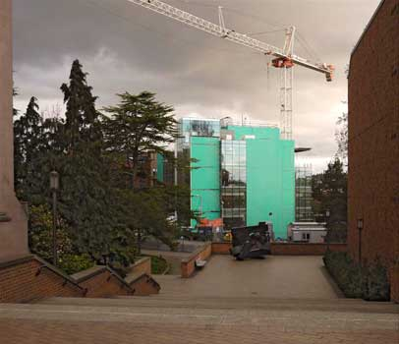
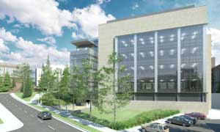

The University of Washington
Molecular Engineering Building
Designed by Zimmer Gunsul Frasca Architects
Construction began 2009 with Completion scheduled for 2012
Building will use BioPCM™ for passive energy storage
Energy Design by Affiliated Engineers Seattle Washington

Slide 28
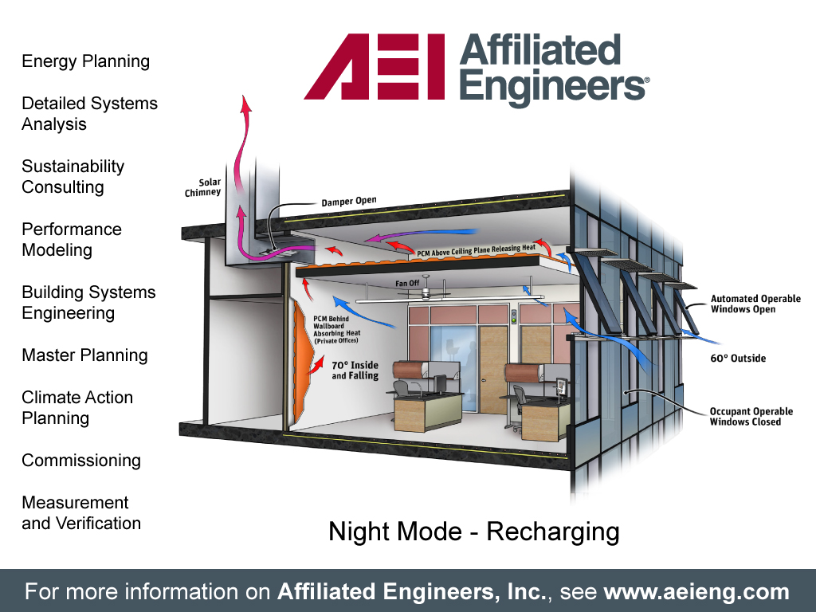

Slide 29

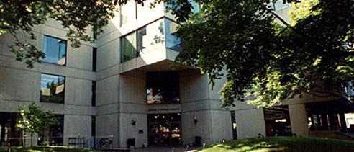
HARVARD Graduate School of Education
Monroe C. Gutman Library Renovation
Ongoing renovation of the Monroe C. Gutman Library will utilize BioPCM™ on multiple floors to help reduce energy costs and increase occupant comfort
BAKER DESIGN GROUP

Slide 30
Current Partners
A key strategy for our company is to jointly work with other manufactures to jointly make phase change products to take to market

Slide 31

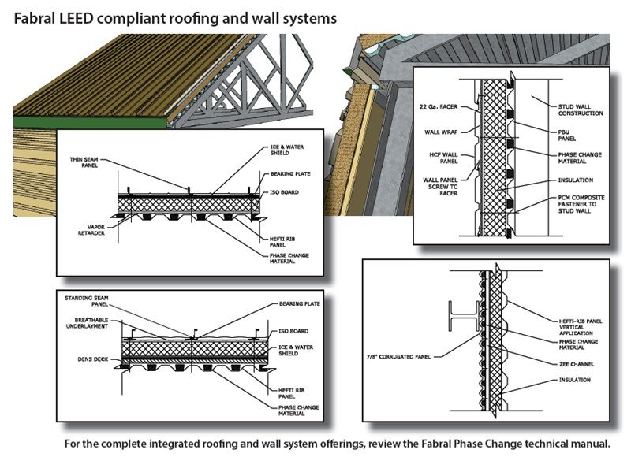
Euramax which owns Fabral had $812 million in sales in 2009
Offering our product in conjunction with their metal roofing
Will begin near-term testing in modular housing in Europe

Slide 32
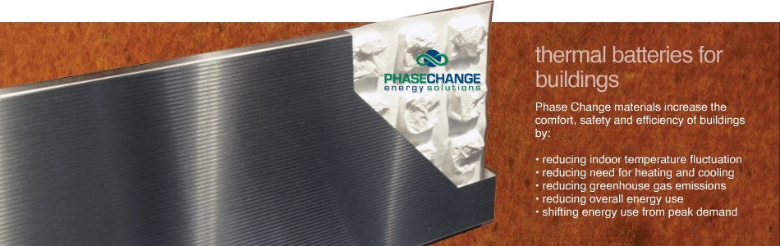
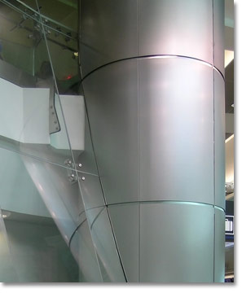

Launched at Greenbuild 2011
Are designing interior metal panels that include our bioPCmatTM
Privately held company – Estimated annual sales of $18 million
Employs 45 people

Slide 33

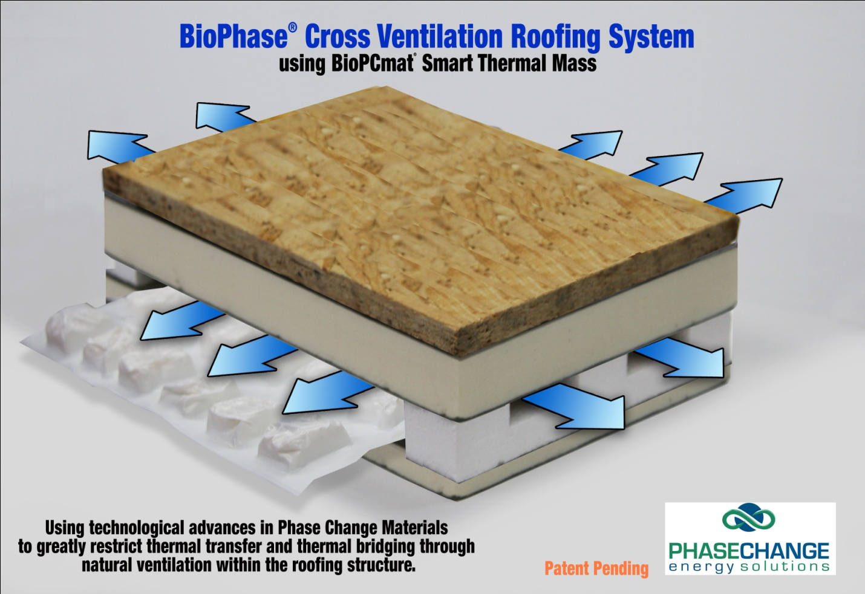
Atlas Roofing
Major manufacturer of roofing materials including insulation and shingles
Privately held company
Estimated sales in the range of $1 billion
Jointly applied for provisional patent on three panels that contain their insulation and our bioPCmatTM product.
Product should be ideal for
placing under flat roof PV, and
under shingles in high energy
efficient homes and buildings.

Slide 34
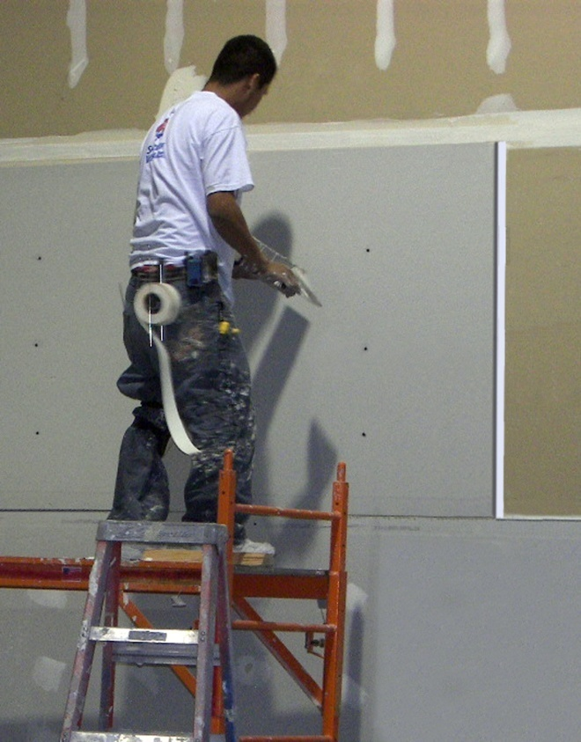
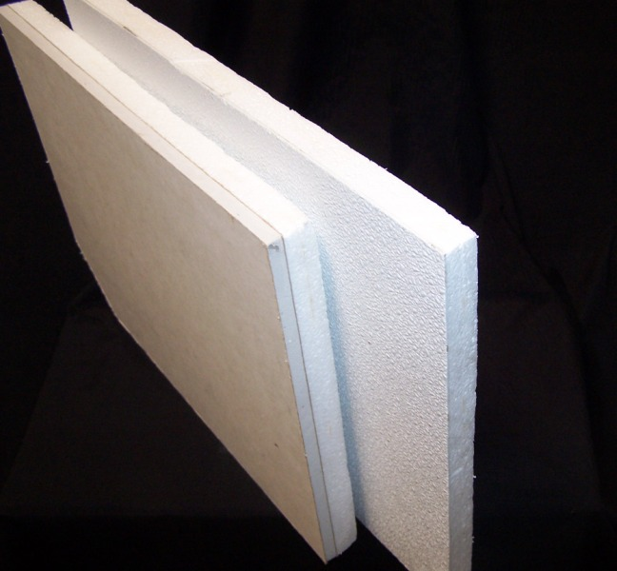
Retrofit Wall Panels
Can be installed over existing walls
Gypsum board outer layer can be finished with traditional methods
FRP class A or class C fire rating available

Slide 35
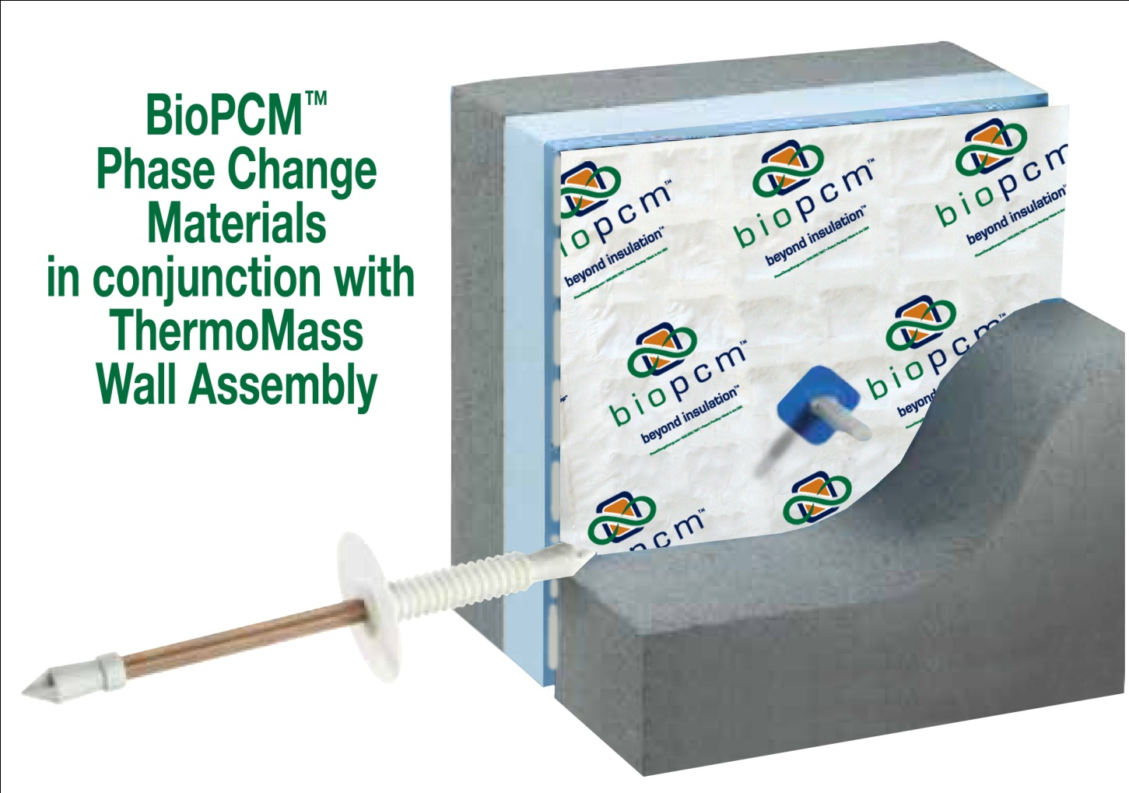
Insulated Concrete Panel Construction

Slide 36




Energy Modeling
Extensive work is underway this year to create standardized processes for modeling BioPCM ™

Slide 37
Our Modeling Solution
Design Builder as an interface for Energy Plus is used to create BioPCM™ design.
Simulation Using Energy Plus, the only validated and tested software capable of modeling PCM’s.
Cross compatibility with other software through GBXML
Secure Collaborative modeling workspace on GreenSpace Live

Slide 38
The Modeling Process
Starting with the architect---Who uses Revit, Archicad, Envisioner, Google sketchup with green space lives' g-modeler plugin or other software capable of creating GBXML.
Upload GBXML file to Green Space Live shared workspace
We model the project using Design Builder/Energy Plus and provide results to project team.

Slide 39
Starting With the Engineer, Modeler, Contractor or Building Owner
Engineer or modeler provides a copy of the current Energy Model, and we convert to Energy Plus.
If no model is available we create one based on CAD files or early stage designs from drawings, blueprints or measurements and some Q&A..

Slide 40
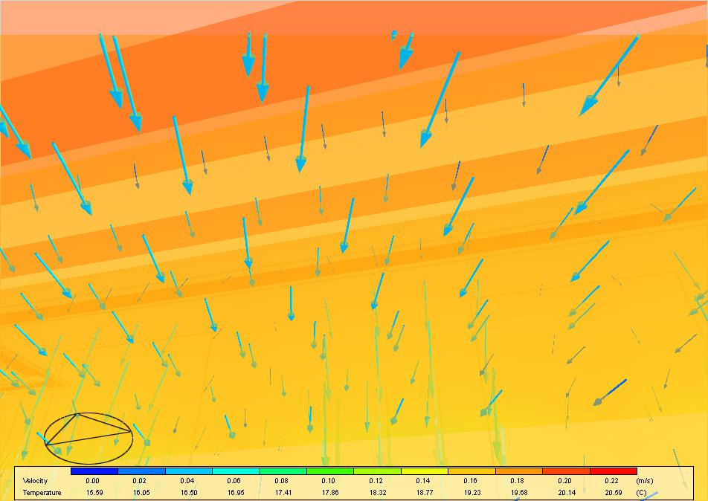
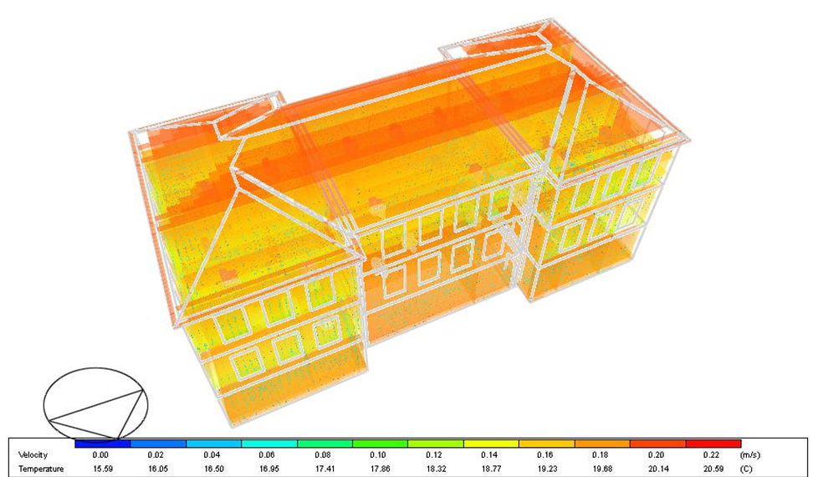
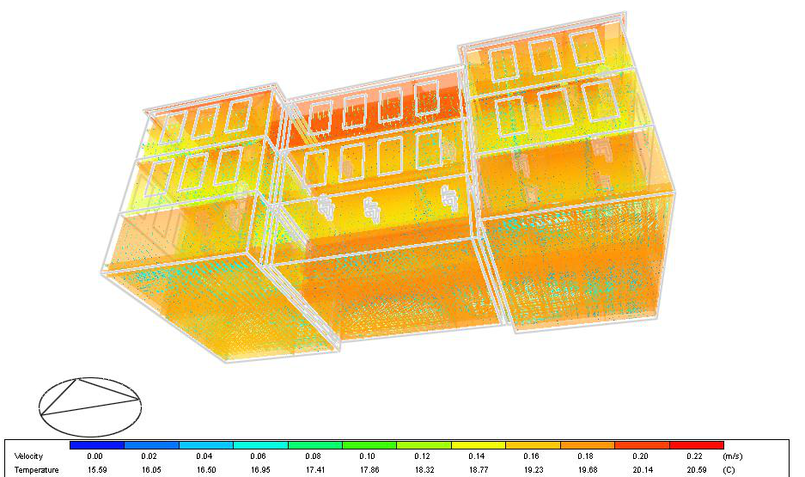
Energy Model aided BioPCM™ Design

Slide 41
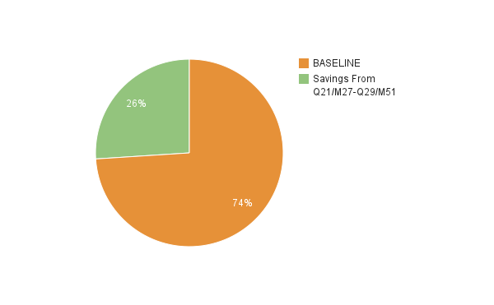
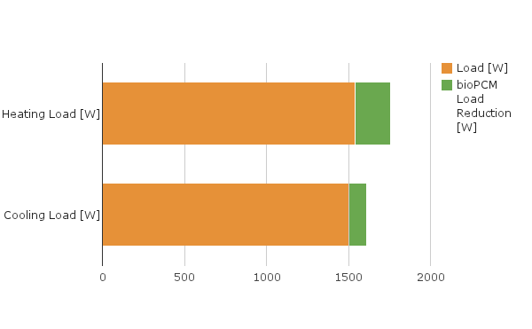
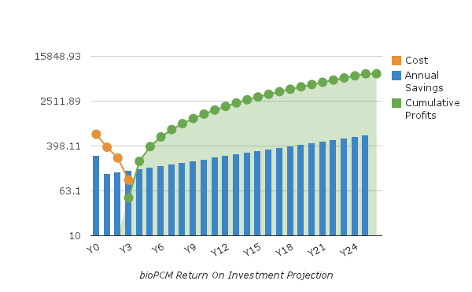
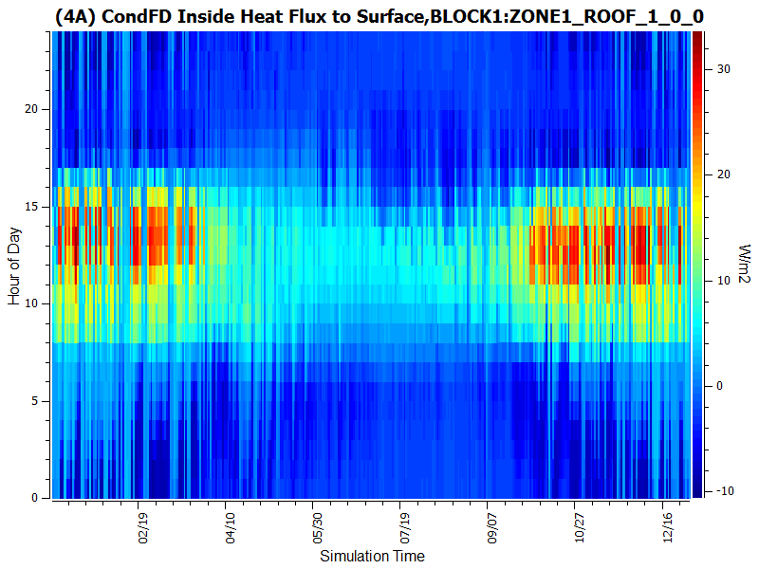
Graphical Reports

Slide 42
Under Development
Working with Andy Tindale, founder of Design Builder to intergrade BioPCM™ modeling directly into their user interface to the Energy Plus simulation engine.
Working with an IES-VE director Craig Wheatley, to develop a PCM algorithm to incorporate into the back end simulation engine (APICHIE SIM)
Developing simplified web-form interface to Energy Plus for BioPCM™ data collection, Amazon EC2 simulation and ROI projections visualized in an Arcview GIS map.

Slide 43


Recently Completed-
Custom coded BioPCM™
“Type 1270” for TRNSYS
Developed by DAVID BRADLEY Principal
Thermal Energy Systems Specialists, LLC22 North Carroll Street - suite 370 Madison, WI 53703 USA P:+1.608.274.2577F:+1.608.278.1475
d.bradley@tess-inc.com
http://www.tess-inc.com http://www.trnsys.com
Developed for the Korean Institute of Construction Technology
To evaluate BioPCM™ for
600+ Meter Lotte Super Tower

Slide 44
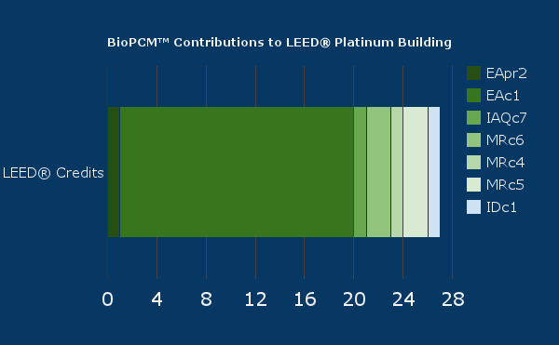
BioPCM™ LEED® Credit Synergies
Minimum Energy Performance EApr2-- Pre-requisite
Optimized Energy Performance EAc1-- Up to 19
Thermal Comfort design IAQc7-- 1
Rapidly Renewable Materials MRc6 -- Up to 2
Recycled Materials MRc4 -- 1
Regional Materials- MRc5 (SW USA ONLY) - Up to 2
Exemplary Energy Performance-IDc1-- 1

Slide 45

“Within twenty years you will see phase change materials being installed in virtually every application where thermal insulation is used today. Smart Thermal MassTM is the future of economic, energy conservation for this generation.“
Jim McColgin – CEO Phase Change Energy Solutions

